Slide 1

Explore a world of data and give some kudos to Kusto
Cédric L. Charlier
@Seddryck

Slide 2

Open-source Contributions
Cédric L. Charlier
@Seddryck
In a nutshell
Testing framework for BI & Data Quality
www.nbi.io
Other projects on github
Deployment SSRS – RsPackage
TmBundle for a few languages
Starting SSIS from .Net - Cassis
Toolset for special cases of modeling: ERMine et Tibre
And much more
seddryck.wordpress.com
Data architect
Agile data warehouse
Quality-oriented
Automation fanboy
Skills & interests
Database architecture
Data modeling
Business intelligence
Data warehousing
ETL
Olap/Tabular
No SQL
Big data
Data analysis
Machine learning
Recognitions
Microsoft MVP Data Platform award since 2014
Agile leader of the month
Experience
20 years working with data on many data platforms
Former consultant, working internally for Elia

Slide 3












Scenario
Exploration
Competitors
Near-instant
Streaming data
Notes:
Streaming data
Get near-instant insights from fast flowing data
Scale lineary up to 200MB/sec per node (high ingestion and low latency)
Designed for data exploration
Run ad-hoc queries using an intuitive query language
On 6 trillions log records, count of full-text search on a single word is returned in less than 3 seconds
Competitors
Compete with ElasticSearch, Splunk, LogStash and InfluxDB
General availability since announced on Feb 7th 2019
Specialized in data streaming (log, telemetry, IoT …)
Optimized for interactive, ad-hoc queries on top of fast flowing data

Slide 4







Integrated with other services
Modern data warehouse
Ingesting
Exploring
Preparation &
training
Modeling & serving
Storing
Notes:
Key sentence: Could be seen as an optimized cache on top of a data lake

Slide 5
Fully managed services (PaaS)
Query
Ingestion
Storage
ADX
Visualization
Indexing
Notes:
PaaS service so no infrastrcture to manage
Query: Powerful intuitive and iterative query language, execute sub-parts
Storage: Data is organized in fields by columns and is considered optimal for analytical query modeling. Storing the data in the sharded column store has its own set of benefits including compression and column-elimination. LZ4 is one of the compression algorithms that is utilized, providing excellent performance and reasonable compression ratio. The data is always held in the compressed mode for faster data transfers. Even when the data is loaded into RAM, it is compressed.
Ingestion: ingest with a high throughput and low latency from different file formats. Support minimal data transformation during this ingestion.
Indexing: This is one thing that sets ADX apart from other exploration tools available today as it provides better performance. It helps ADX in deciding which
data extents should be targeted as a part of the query. This in turn helps in better performance as it allows scanning only a small subset of the data.
Visualization: Data exploration requires visualization capabilities. Just taking a look to tables of results won’t make it. You need some charting capabilities directly embedded into the tool.

Slide 6

Azure Time Series Insights
Built on top of ADX
Azure Monitor Log Analytics, Application insights, and Azure Security Insights are other pre-built solutions on top of ADX for a specific purpose
SaaS part of the IoT product suite (ADX is PaaS)
ADX is a layer deeper (more custom solutions but more code)

Slide 7








Ingestion
Ingestion
Streaming hubs
Streaming pipelines
Batch pipelines
Programmatic ingestion

Slide 8
Data Ingestion Overview
Ingestion
ADX Cluster
Streaming hubs
Data management
Engine
Connections
Batching
Streaming pipelines
Ingestion
Batch pipelines
Management
Programmatic ingestion

Slide 9
Kusto Query Language ingestion
Ingestion
Commands to ingest data directly into ADX
Only for data exploration and prototyping: bypasses the data management services
.ingest inline
.ingest set/append/set-or-append/set-or-replace
.ingest into

Slide 10
Tooling for ingestion
Ingestion
One-Click Ingestion:
wizard
automation of tasks such as creating tables and mappings
on-event or one-time
LightIngest
Command line utility
ad-hoc data ingestion
pull data from the local folder or from the Azure blob storage container

Slide 11
Data storage
Storage
Azure Compute RAM
Three top technologies:
column store
text indexing,
data sharding
Each data shard
composed of one or more blobs
Data shard is immutable
Hot storage
(cache)
Azure Compute SSD
Compressed data
Azure Blob Storage
Cold storage
Notes:
Storing data in a sharded column store makes it possible to store huge data sets, as data arranged in column order compresses better than data stored in row order. Query performance is also improved, as sharding allows one to utilize all available compute resources, and arranging data in columns allows the system to avoid loading data in columns that are not required by the particular query. The text index, and other index types, make it possible to efficiently skip entire batches of records when queries are predicated on the table’s raw data.
It allows multiple Compute nodes in the cluster to cache the data shard, without complex change management coordination between them.
It allows multiple Compute clusters to refer to the same data shard.
It adds robustness to the system, as there’s no complex code to “surgically modify” parts of existing storage artifacts.
It allows “travel back in time” to a previous snapshot as long as the storage artifacts of the data shard are not hard-deleted.
While Azure Data Explorer is careful to isolate Compute and Storage, it makes full use of the local volatile SSD storage as a cache – in fact, the engine has a sophisticated multi-hierarchy data cache system to make sure that the most relevant data is cached as “closely” as possible to the CPU. This system critically depends on the data shard storage artifacts being immutable, and consists of the following tiers:
Azure Blob Storage – persistent, durable, and reliable storage
Azure Compute SSD (or Managed Disks) – volatile storage
Azure Compute RAM – volatile storage
An interesting aspect of the cache system is that is works completely with compressed data. This means that the data is held compressed even when in RAM, and only decompressed when needed for an actual query. This makes optimal use of the limited/costly cache resources.

Slide 12
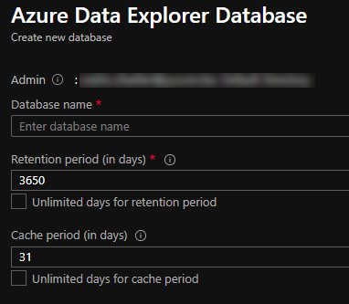
Data grooming
Settings at database level
Retention based on ingestion time
Know your clients (or their query patterns)!

Slide 13
Kusto language
KQL means Kusto Query Language
A Kusto query is a read-only request to process data and return results
Designed to make the syntax easy to read, author and automate
Similar concepts than SQL for structure (database, table, column)

Slide 14
Query vs Command
Query
Queries return a data set (set of records)
Commands act on the clusters, databases or tables but not on data
Commands start with a dot (« . »)
Expl: .show .ingest …
Both must be submitted to distinct endpoints

Slide 15
101 of the syntax
Query
Start by the name of the table (optionaly quoted between brackets)
A pipe (« | ») is separating the operations
A semi-column is specifying the end of a batch of operations
Last operation can be a render instruction
TableName
| Operator1
| Operator2
| Render;

Slide 16
Procedural language
Query
Output
=
Tabular data set
TableName
| Operator1
Input
=
Tabular data set
| Operator2
| Render;

Slide 17
Limit rows returned
Query
ADX will always limit the final result to 5000 rows
« limit » doesn’t guarantee any order (synonym of take)
« top » returns the first N records sorted by the specific columns
« where » filters a table to the subset of rows that satisfy a predicate.

Slide 18
Projection
Query
ADX will always limit the final result to 5000 rows
« project » selects the column to include
« project-away » selects the column to exclude
« project-rename » renames some columns of the output
« project-reorder » sets the the first columns of the output

Slide 19
Projection and extention
Query
ADX will always limit the final result to 5000 rows
« project » selects the column to include
« project-away » selects the column to exclude
« project-rename » renames some columns of the output
« project-reorder » sets the the first columns of the output
« extend » creates calculated columns

Slide 20
Indexing
Indexing
Index at the shard level
Allow parallel ingestion by multiple compute nodes
Index not linked on records but on sets approx. 1000 records
Efficient to generate and load
After a hit, set of records must be scanned
Shards and indexes merged in background
Notes:
The ability to index free-text columns and dynamic (JSON-like) columns at line speed is one of the things that sets our technology apart from many other databases built on column store principles. Indeed, building up an inverted text index (Bloom filters are used for low-cardinality indexes, but are rarely useful for free-text fields) is a complex task in Compute resources (hash table often exceeds the CPU cache size) and Storage resources (the size of the inverted index itself is considerable).
Azure Data Explorer has a unique inverted index design. In the default case, all string and dynamic (JSON-like) columns are indexed. If the cardinality of the column is high, meaning that the number of unique values of the column approaches the number of records, then the engine defaults to creating an inverted term index with two “twists”. The index is kept at the shard level so multiple data shards can be ingested in parallel by multiple Compute nodes, and is low granularity so instead of holding per-record hit/miss information for each term, we only keep this information per block of about 1,000 records. A low granularity index is still efficient in skipping rarely occurring terms, such as correlation IDs, and is small enough so it’s more efficient to generate and load. Of course, if the index indicates a hit, the block of records must still be scanned to determine which of the individual records matches the predicate, but in most cases this combination results in faster (potentially much faster) performance.
Having low granularity, and therefore small, indexes also makes it possible to continuously optimize how data shards are stored in the background. Data shards that are small are merged together as a background activity, improving compression and indexing. For example, because the data they contain comes in continuously and we want to keep query latency small. Beyond a certain size, the storage artifacts holding the data itself stop getting merged, and the engine just merges the indexes, which are usually small enough so that merging them results in improved query performance.

Slide 21
Free-text indexing
used in queries with the string operators that have has as part of their name
used in queries with the string operators that have has as part of their name
Indexing
Multiple indexes are built for string columns
Used in queries with a “has”-like operator
Not a substring-match but a term-match
A term is a substring delimited by specific chararcters (space, dashes, comas …) with a minimal length of 4
2020-08-02 table, chair ABCDE-12345-78 or XYZXY-78901-92
Term

Slide 22
Free-text operators
Query
« contains », « startswith » and « endswith » are not using the term indexes (full scan)
« has » using the term indexes
Using of variantes with « prefix » and « suffix »
Using the variantes with « _cs » for case sensitive
« == » is case-sensitive but « =~ » is not
Performance:
Use terms and not substring: « has » in place of « contains »
Use case-sensitive and not insensitive

Slide 23
Distinct and facets
Query
« distinct » just as in SQL
« facets » explores a column and return distinct values and counts

Slide 24
Summarize
Query
« summarize » produces a table that aggregates the content of the input table.
You can have more than one aggregation on a summarize
Broad range of aggregation supported: max, count, sumif … (>30)
Null values don’t participate to the aggregation (except count)
« by » to group rows by unique combinations
« bin » to group rows by buckets of values

Slide 25
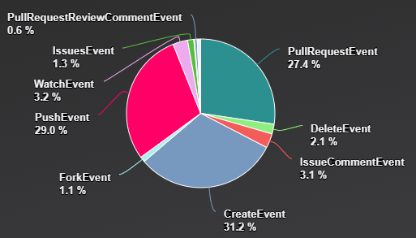
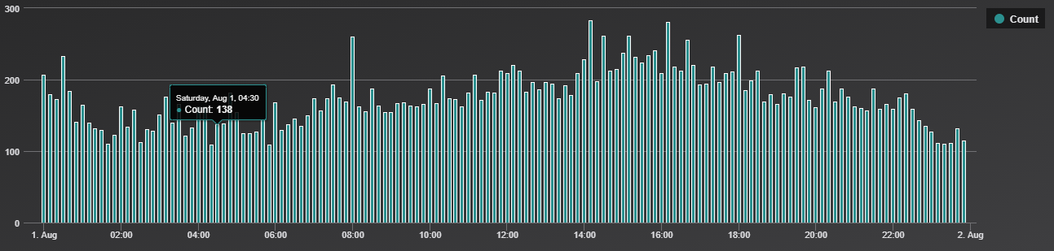
Charting engine
Visualization
Out-of-the-box in ADX
Useful for trending
To be improved in Azure Data Studio

Slide 26
Declaration and jointure
« let » gives a name to an expression (scalar, tabular or function)
« join » merge rows of two tables to form a new table by matching values of specific columns from each table

Slide 27
Create time-series and exploit them
« make-series » create series of specified aggregated values along a specified axis.
« mv-expand » transform a multivalued (dynamic) column so each value of the cell get its own row
« mv-apply » applies a subquery to each value of a multivalued (dynamic) column, and returns the union of the results of all subqueries
« series_... » list of functions empowering time series

Slide 28
Thanks for attending this session and have a nice day!

